Slide 1

Infrastruktura e serverEVe
server infrastructure
Osman Osmani
Prishtinë

Slide 2
server infrastructure
Topic 1 – Introduction (Server Infrastructure Concepts), Virtualization

Slide 3
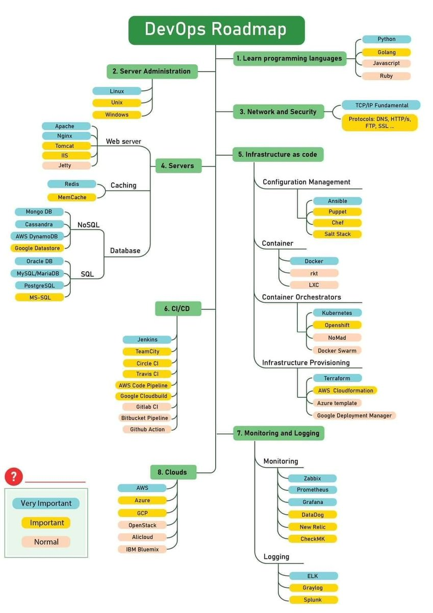
Roadmap

Slide 4
Hyrje
Objektivat
Infrastruktura Serverike
Pyetjet Hulumtuese
Metodologjia
Analiza dhe konkluzionet

Slide 5
Server Farm - Shërbimet
Active Directory (AD)
Administrimi i Shfrytëzuesit (Users)
Dynamic Host Configuration Protocol (DHCP)
Domain Name System (DNS)
Group Policy Object (GPO)
Demilitarized Zone (DMZ)
Shërbimet e Studenteve
Firewall (FW)
Monitorimi
Siguria
Database Server (DBS)
Baza e të dhënave
File Server (FLS)
Hapësirat e shfrytëzuesve (User Drives)

Slide 6
Server Farm - Shërbimet
Web Server (WS)
Internet Information Service (IIS)
Publikimi i web faqeve – shërbimeve elektronike
SharePoint
Menaxhimi I Dokumenteve
Bashkëpunimi
Mail Server
Administrimi i email-av (staf dhe student)
Backup Server
Ruajtja e shënimeve (backup)
Windows Server Update Services
Rifreskimi (update) i serverëve dhe klientëve

Slide 7
UBT Infrastruktura
Kërkesat
Centralizimi i shfrytëzuesve
Menaxhimi i kompjuterëve
Menaxhimi i dokumenteve
Sistemi i Email-ve
Sistemi për ruajtjen e te dhënave
Shërbimet elektronike
Siguria

Slide 8
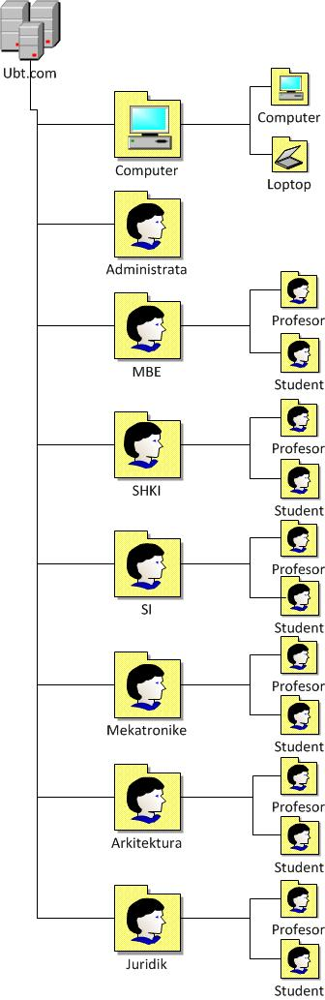
Active Directory (AD)
Active Directory (AD)
Administrimi i Shfrytëzuesit (Users)
Dynamic Host Configuration Protocol (DHCP)
Domain Name System (DNS)
Group Policy Object (GPO)

Slide 9
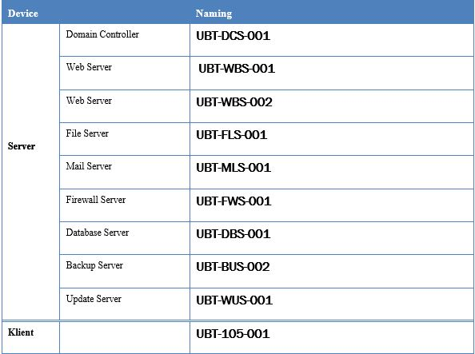
Naming Convention
Naming Convention
Shkurtesa e Institucionit
Emri i serverit (roli) , numri i zyrës
Numri rendor

Slide 10
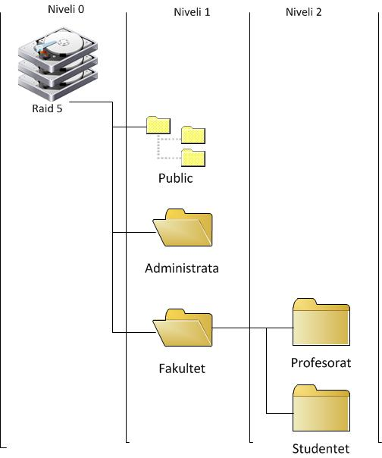
File Server (FLS)
File Server (FLS)
Hapësirat e shfrytëzuesve (User Drives)
Nivelet e qasjes
Aplikimi i rregulloreve (File Screening)

Slide 11
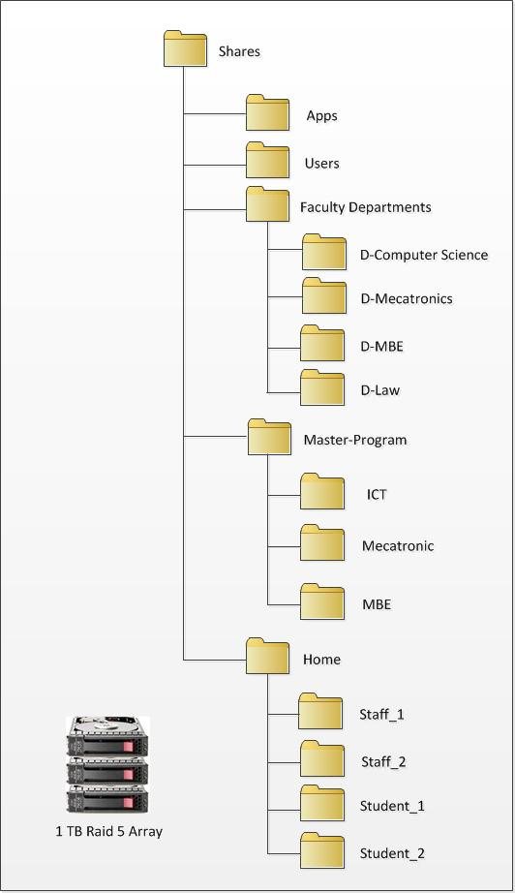
File Server (FLS)
File Server (FLS)
Struktura Organizative

Slide 12
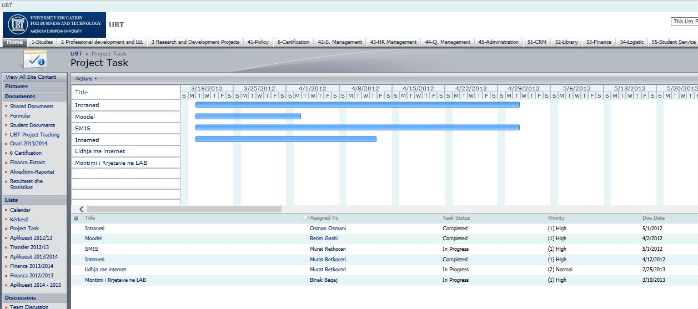
SharePoint (intranet)
Menaxhimi i dokumenteve
Bashkëpunimi ne mes te stafit, departamenteve

Slide 13
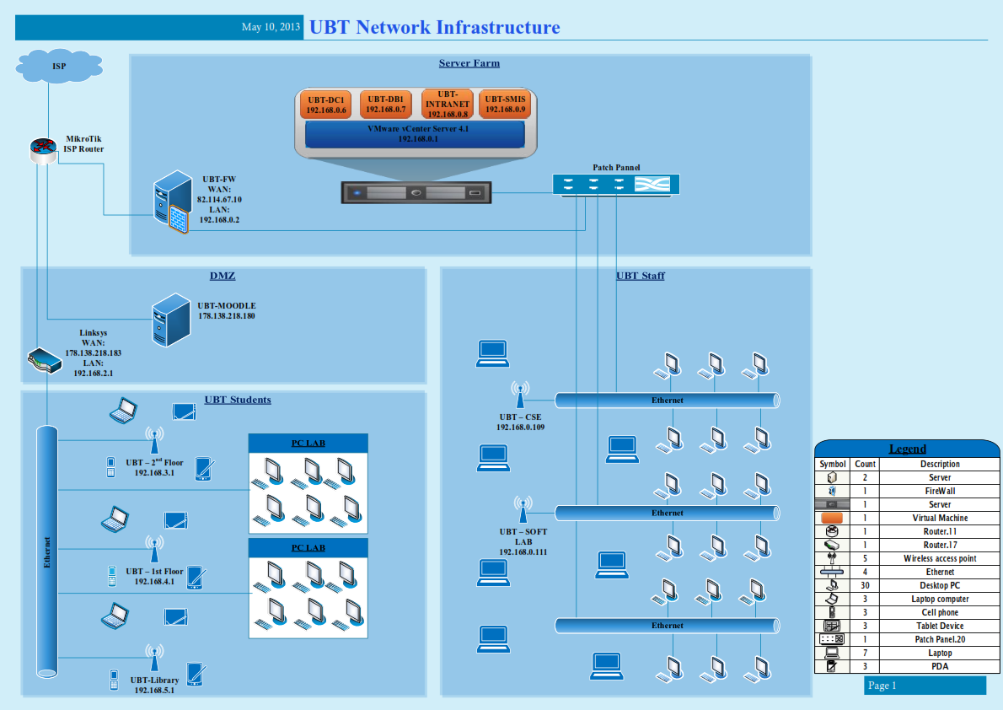
Analiza dhe konkluzionet

Slide 14
server infrastructure
Virtualization
Microsoft Windows Server Editions
Microsoft Windows Server Services
Active Directory

Slide 15



virtualization
What is Virtualization?
Virtualization is the process of creating a software-based or virtual, version of something.
Old but still relevant
Desktop Virtualization
Server Virtualization
Network Virtualization
Storage Virtualization
Application Virtualization

Slide 16
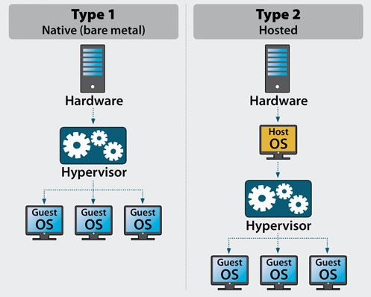
virtualization
Virtualization Types
Type 1 / Bare Metal
Type 2 / Hosted

Slide 17
virtualization

Slide 18
virtualization
Type 1 / Bare Metal
Applications
Applications
Applications
V i r t u a l
Guest OS (Windows)
Guest OS (Linux)
Guest OS (VMware ESX)
Virtual Machine
Virtual Machine
Virtual Machine
Virtualization Layer (Hypervisor)
P h y s i c a l
Hardware

Slide 19
virtualization
Type 2 / Hosted
V i r t u a l
Applications
Applications
Applications
Guest OS (Windows)
Guest OS (Linux)
Guest OS (VMware ESX)
Virtual Machine
Virtual Machine
Virtual Machine
P h y s i c a l
Virtual Machine Manager(Server Products)
Host OS(Server Products)
Hardware

Slide 20
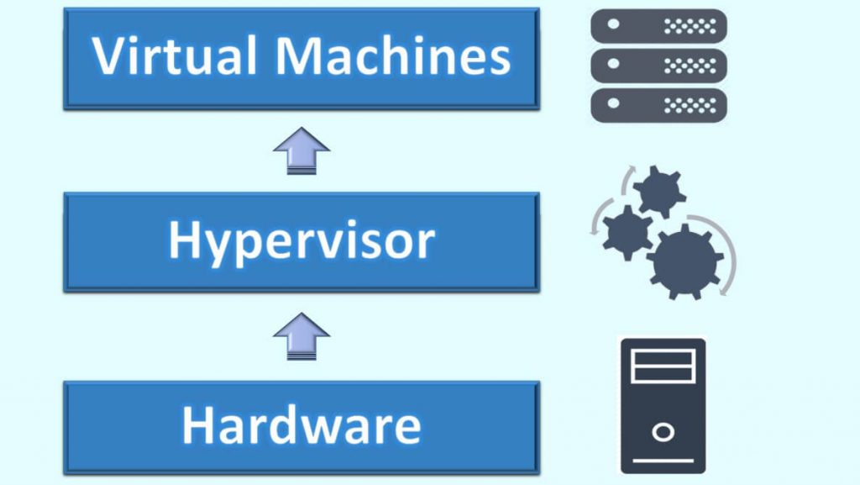
virtualization
What is a hypervisor?
A hypervisor, also called a virtual machine manager (VMM), is a program that allows multiple operating systems to share a single hardware host. Each operating system appears to have the host's processor, memory, and other resources all to itself. However, the hypervisor is actually controlling the host processor and resources, allocating what is needed to each operating system in turn and making sure that the guest operating systems (called virtual machines) cannot disrupt each other.

Slide 21

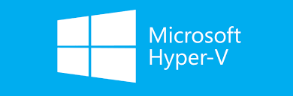
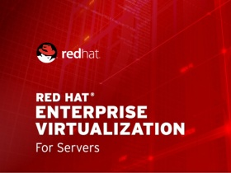

virtualization
Type 1 Hypervisors:
VMware vSphere / ESXi
Microsoft Hyper V
Xen / Citrix XenServer
Red Hat Enterprise Virtualization (RHEV)

Slide 22
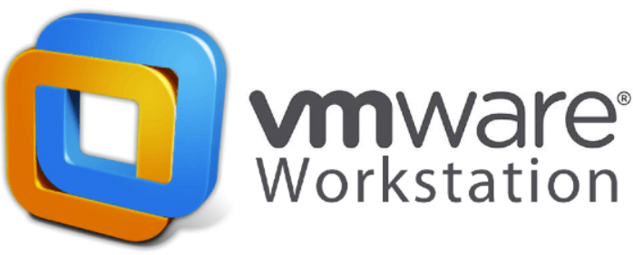
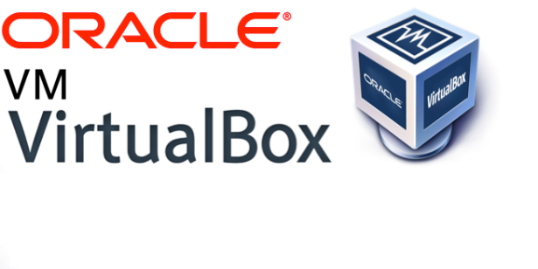
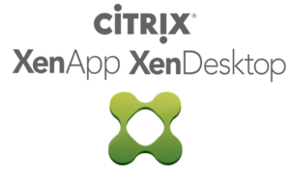
virtualization
Type 2 Hypervisors:
VMware Workstation
Microsoft Hyper V
Oracle VM VirtualBox
Citrix XenServer

Slide 23
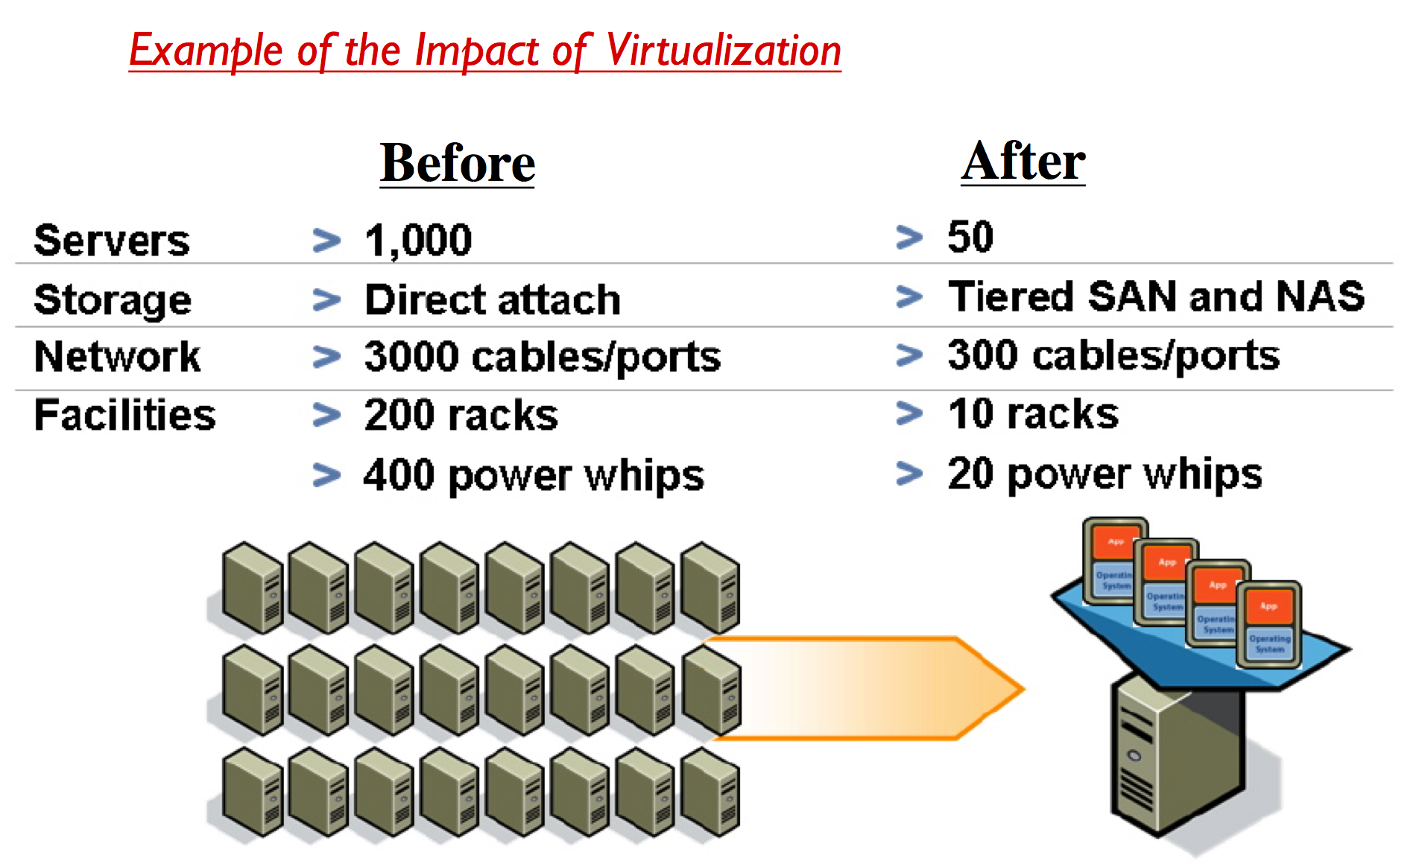
virtualization
Benefits from Virtualization:
Cost Savings
Flexibility
Centralization
Speed
Downtime
Disaster Recovery

Slide 24
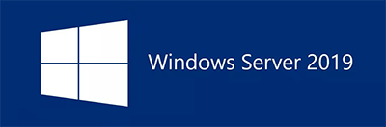
Microsoft Windows Server
Microsoft Windows Server
Versions (NT 3.1 – 2019)
Editions 2019 (Standard, Datacenter)
Releases
x86 - 2012
Update, Upgrade, Migrate

Slide 25
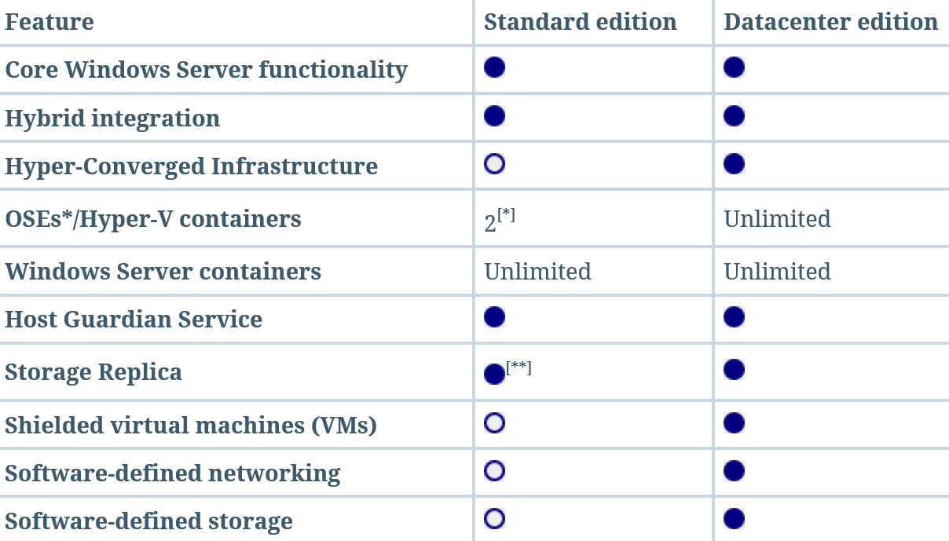
Microsoft Windows Server
Microsoft Windows Server - Editions

Slide 26
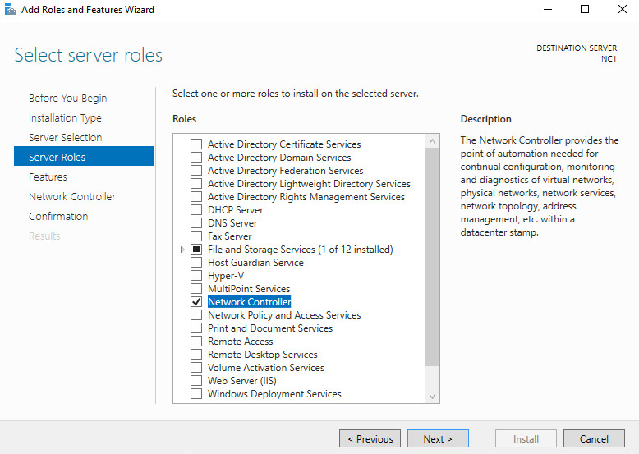
MICROSOFT WINDOWS SERVER Services
Microsoft Windows Server – Services / Roles

